Slide 1
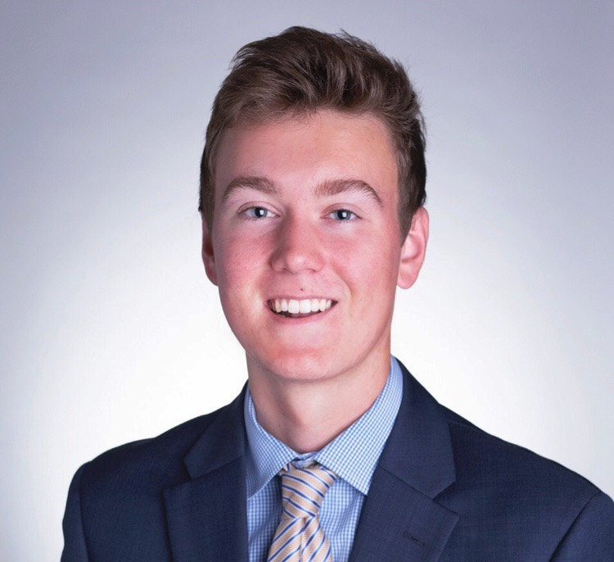
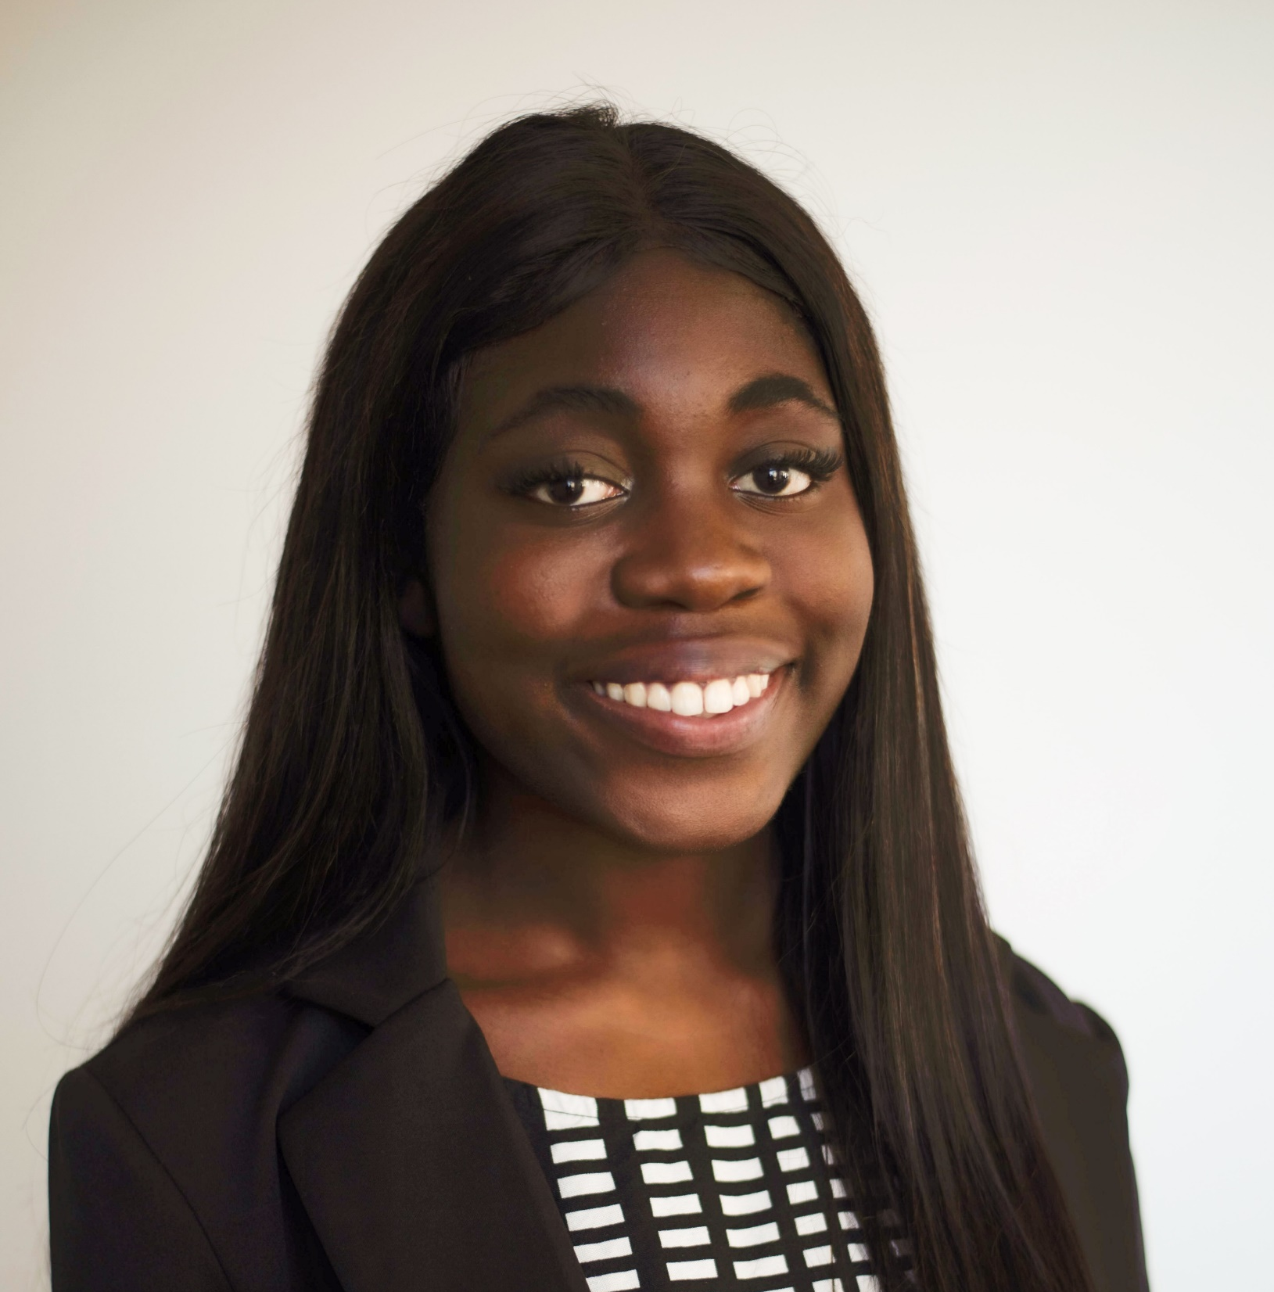
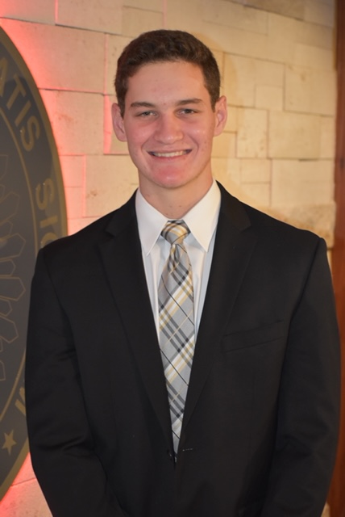
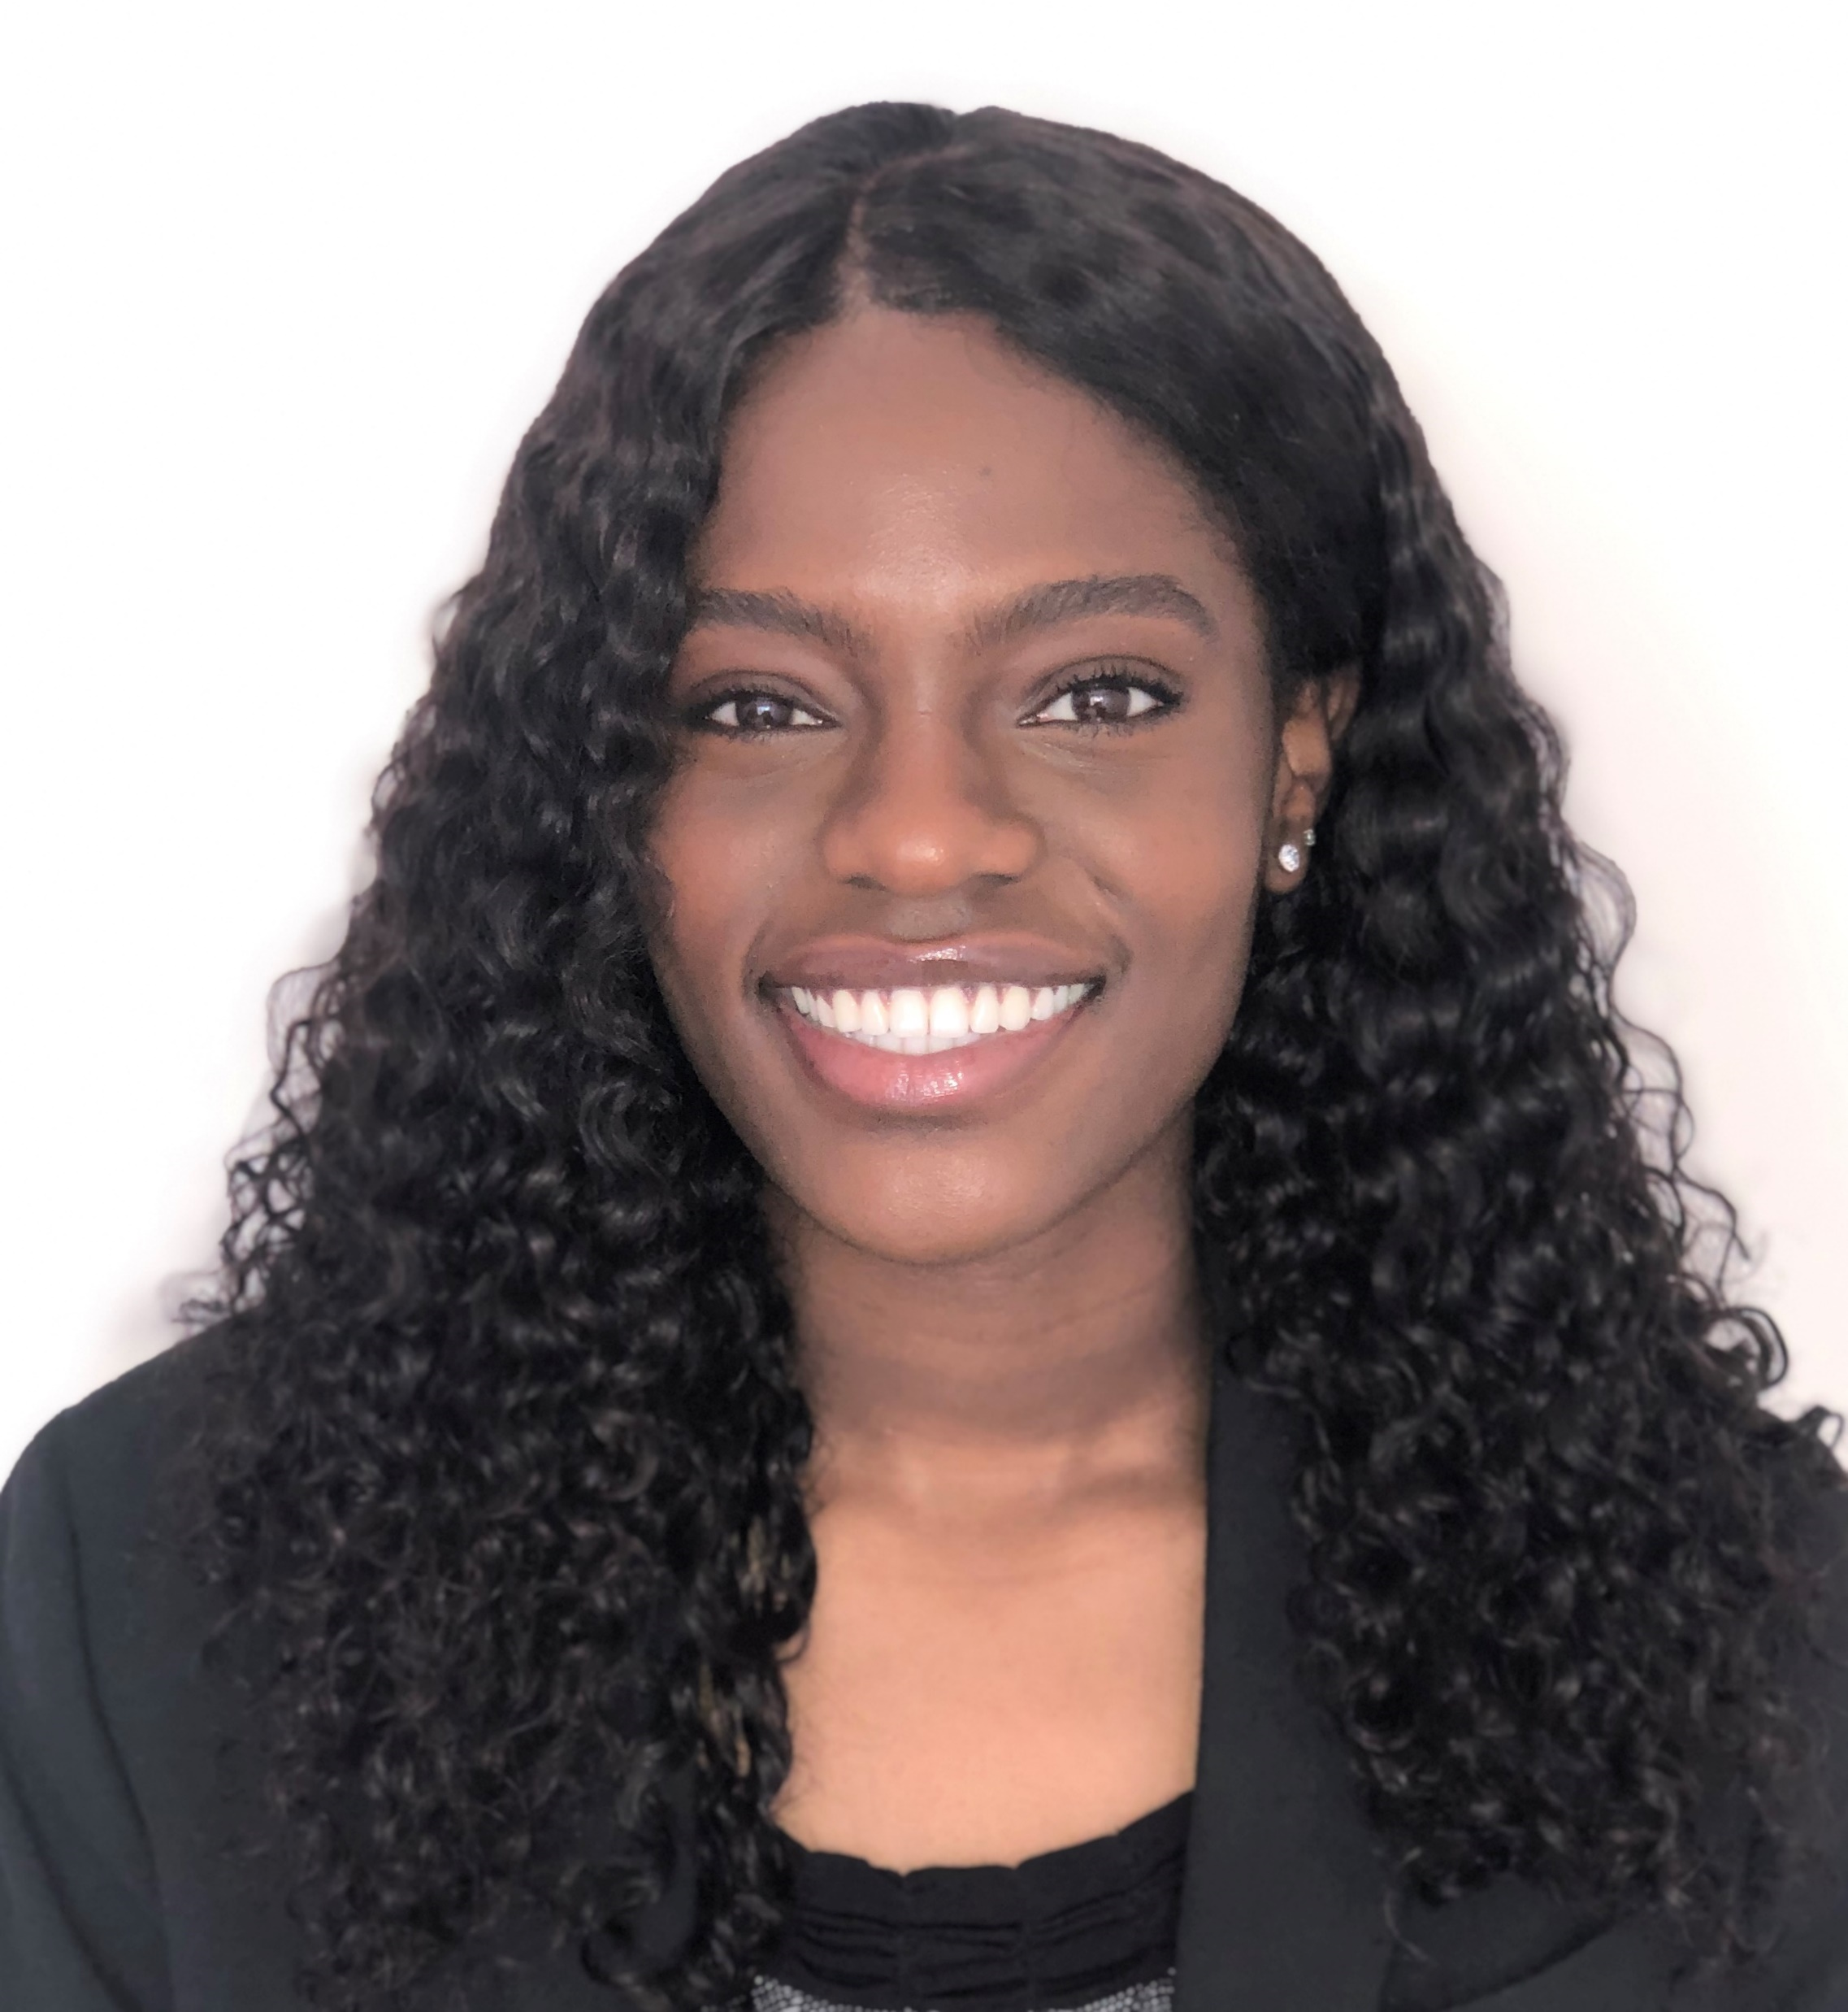
Kelley Impact Competition: Get to know the Team
Davis Aufdembrink
Sika Kodzi
Robbie Levine
Lorraine Michira
Involvement:
Incoming Investment Banking Analyst at William Blair
Capital Markets & Banking Workshop, DSP Business Fraternity, President of Civic Leadership Development Club, Teaching Assistant @ the Kelley School of Business, IU Amazon Prime Campus Manager, Kelley Honors Program Mentor
Involvement:
Incoming Associate at Boston Consulting Group (BCG)
Involvements: Consulting Workshop, Director of Professional Development for Women in Business, DSP Business Fraternity, Kelley Honors Program
Involvement:
Incoming Associate at Bain & Company
Finance & Accounting intern at Procter & Gamble
Consulting Workshop, IU Athletic Department tutor, 180 Degrees Consulting, DSP Business Fraternity, Kelley School of Business Teaching Assistant, Kelley Honors Program Mentor
Involvement:
Incoming full time Audit team at KPMG
Global Sales Workshop, Kelley Guide, Best Buddies, Hudson and Holland Tutor, Kelley Black Student Task Force, William R Fry and Hudson and Holland Scholar, State Farm Sales Team Member
20

