Slide 1
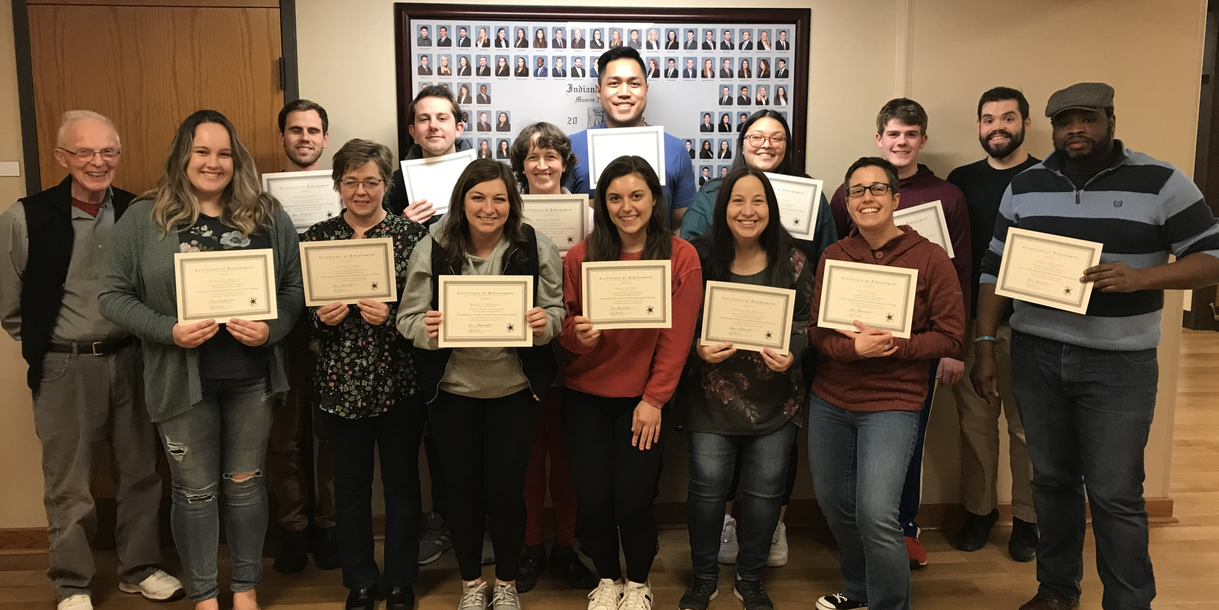
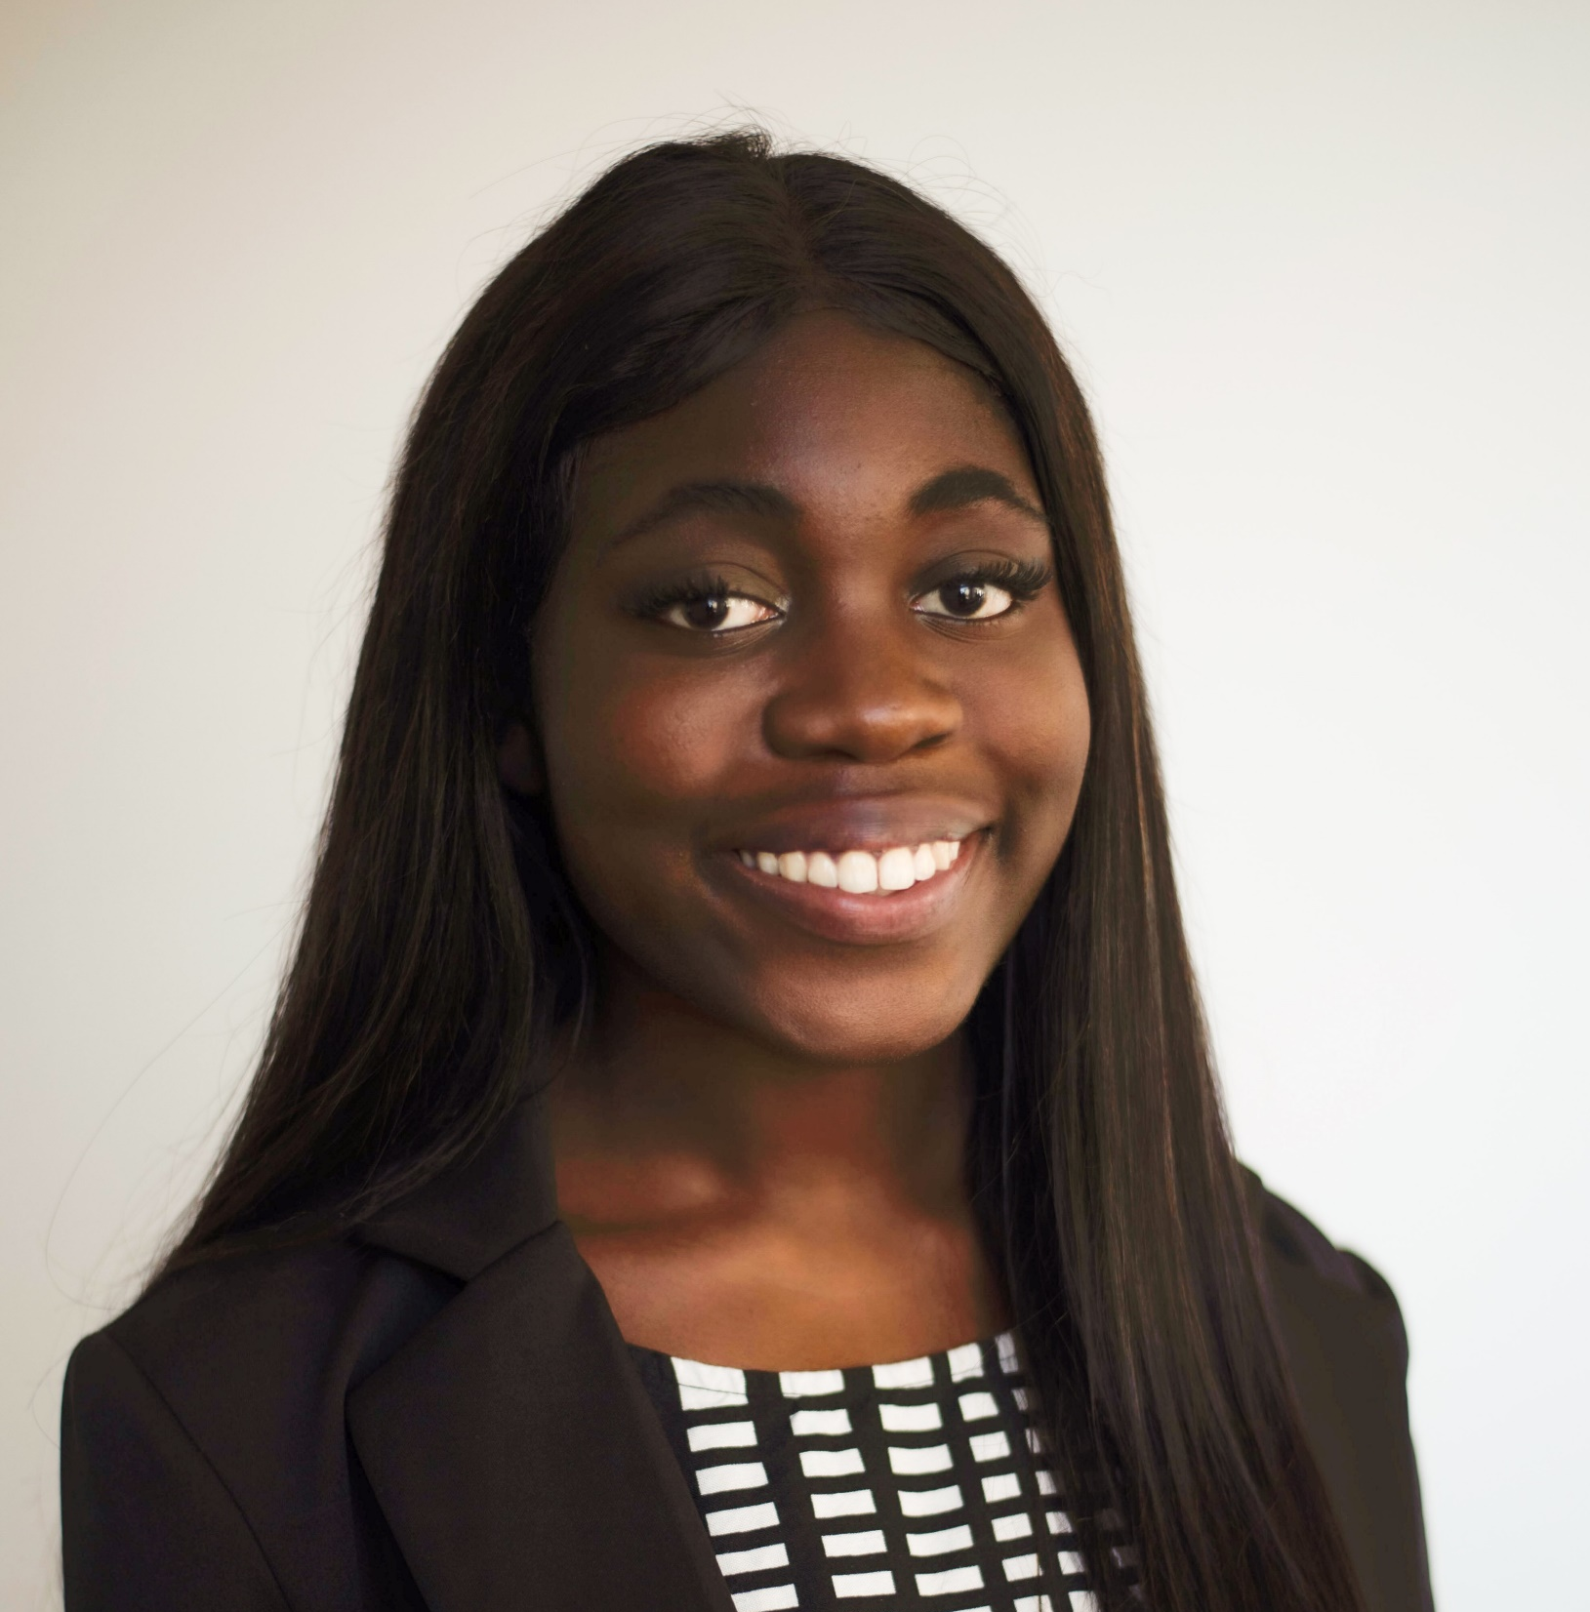
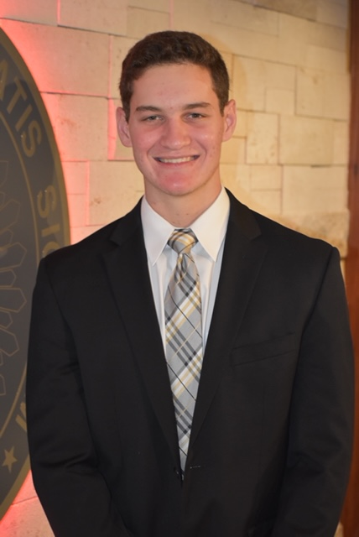
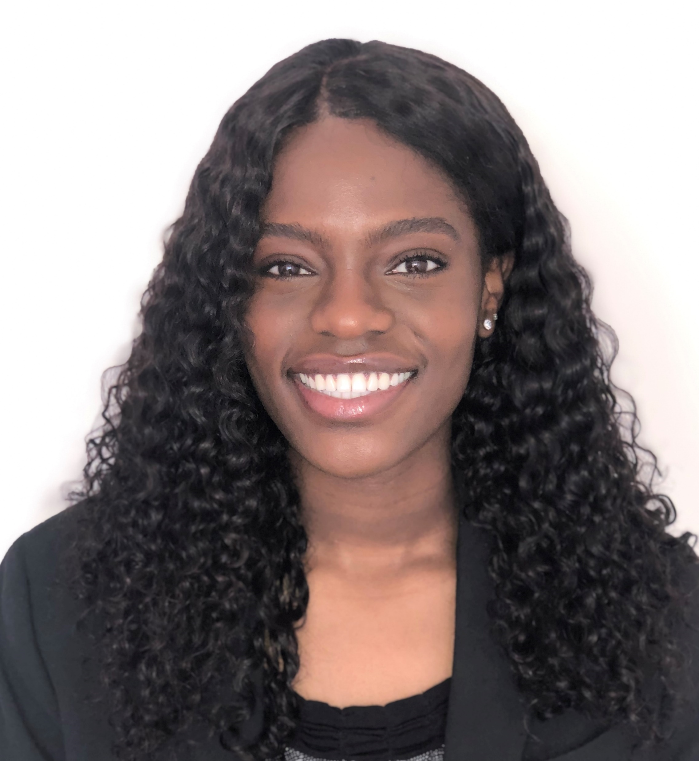
Inspiring CJAM’s Tomorrow
Team Inspire Solutions presenting to Community Justice & Mediation (CJAM) on April 9th, 2021
Davis Aufdembrink
Sika Kodzi
Robbie Levine
Lorraine Michira

Slide 2
Currently, CJAM faces limited human capital, a lack of diversity, and limited awareness of their services
Limited Human Capital
Lack of Diversity
Limited Awareness and Understanding
2
Notes:
They have limited human capital
Lack of diversity
Lack of awareness and understanding

Slide 3
A Round-Up Rent donation program, enhanced marketing efforts, and forming a diversity committee will yield CJAM long-term success
Rent
Marketing
Round-Up Rent raises awareness and generates revenue
Effective marketing will aid participation in Round-Up Rent
Diversity
Diversity committee will ensure CJAM is reaching all clients
Partner with landlords to offer program
Marketing video easily explains CJAM
)
Formed to represent all types of CJAM clients
Tenants find out about CJAM while donating
T-Shirts for Round-Up Rent participants increases awareness
Varied representation will ensure all voices are heard
64% of people say they would participate
Quarterly newsletter increases touchpoints
Will plan events and create processes
3
Notes:
Very brief current situation
Overview of 3 steps and what we hope to accomplish

Slide 4
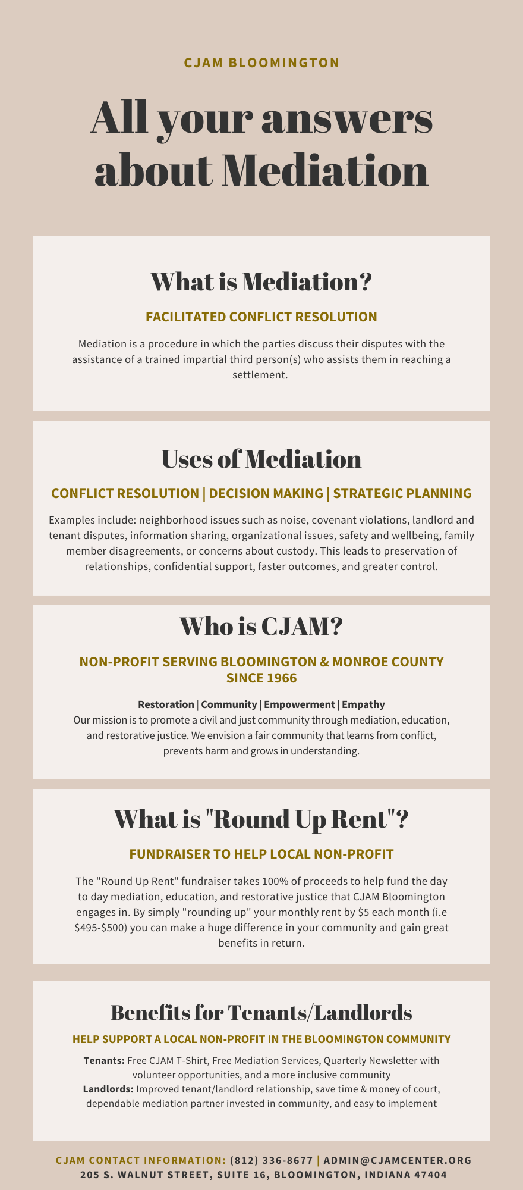
The Round-Up Rent donation program benefits tenants, landlords, and CJAM all at the same time
CJAM 1-Pager
Round-Up Rent is a program where a tenant can opt-in to rounding up their rent each month and this extra rent is donated to CJAM
Tenants
Landlords
CJAM
Pay extra rent each month (i.e. round-up rent from $495 to $500 each month)
Collects the extra rent and pays CJAM semiannually
Gains awareness and revenue and provides free services for the other two parties
Rent
Marketing
4
Diversity
Notes:
”Round up” Rent Program description + user experience ie (paying the money, learning about cjam through newsletter

Slide 5
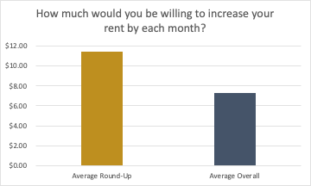
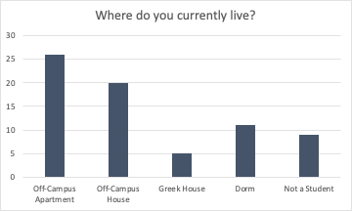
The rent survey responses yielded promising support for the Round-Up Rent donation program
Inspire Solutions Rent Survey Responses:
64.5%
35.5%
Voted “Yes” to rounding up their rent
Voted “No”
Rent
Marketing
5
Diversity
Notes:
Ask for excel or recopy grpahs
Show rent survey and analysis
Give list of potential landlords
Show the flow charts
For the opt-in option, make the round-up $5
Be honest about the landlord potential in the risks section, but give mitigation of how we will start with smaller landlords and work our way up
Give them an answer on how they will get their money (6-month payment plan)
Write 1-pager
Give description to landlords of what CJAM can do for them
Explain how the money will flow
What all the parties get (t-shirts, tax deductible?, free services)
Make the risks associated with it and our notes from landlords in the Q&A

Slide 6
The Round-Up Rent donation program saves time and money, improves relationships, and provides benefits for all parties
incentives for Landlords/Patrons
Save Time/Money of Court
Improve Relationships
Benefits of Services
Resolving disputes in court can be a costly process
This program brings awareness to the benefits of community mediation
Educating potential clients about CJAM early on yields future clients
Both tenants and landlords benefit when their relationship is better and more trustworthy
Tenants receive a free CJAM t-shirt and free mediation services
Landlords are encouraged by potential tax deductions and their tenants have access to mediation
Rent
Marketing
6
Diversity
Notes:
Explain the program
Chart (% yes/no) pie, (where they live pie), average donation before/after,
Takeaways

Slide 7
UpWork will connect CJAM with professionals to create a marketing video to increase awareness on CJAM’s services and volunteer opportunities
Budget: $4,500 will be allocated towards the animated, informational video.
Effectiveness of a Marketing Video
Steps to Create Job Posting
1
1
Write headline to list job posting
Human brains process images/video 60,000 times faster than text
2
11
1
Select the required skills for the project
3
1
Estimate the scope of work
Animation videos are 0.75 times cheaper than live action videos
4
1
Select preferred talent location)
Rent
Marketing
7
Diversity
Other Notes
Allocating $5000 towards video (leftovers can be reinvested into DEI committee
Video will also be posted on the website, facebook, shown to landlords, and potential Round up rent partcipants
Notes:
https://www.skeletonproductions.com/insights/animation-vs-live-action
https://simpleshow.com/us-en/blog/why-animation-is-better-than-live-action-video/
https://www.t-sciences.com/news/humans-process-visual-data-better
Describe video making process

Slide 8
CJAM branded shirts and a quarterly newsletter will assist increasing brand awareness across the Bloomington community.
CJAM Branded T-shirt
US Consumer Habits
Eye-catching design with CJAM logo, description of services, contact information, and scannable QR code. Made by black owned print shop.
*Say branded apparel helps recall the company’s name
85%
*Feel more favorable to firms who gave them free shirts
57%
Quarterly Newsletter
Converting donors to volunteers.
Includes: CJAM updates, volunteer training times, donation links to make an additional donation, testimonials, section from DEI committee, financials, etc.
Don’t volunteer because they haven’t been asked
45%
Forwarded a message from a charity to a friend or colleague
42%
Would donate again, if charity showed how money was spent
33%
Rent
Marketing
8
Diversity
Notes:
https://www.skeletonproductions.com/insights/animation-vs-live-action
https://simpleshow.com/us-en/blog/why-animation-is-better-than-live-action-video/
https://www.t-sciences.com/news/humans-process-visual-data-better
Describe video making process

Slide 9
CJAM branded shirts and a quarterly newsletter will assist increasing brand awareness across the Bloomington community.
CJAM Branded T-shirt
US Consumer Habits
Eye-catching design with CJAM logo, description of services, contact information, and scannable QR code. Made by black owned print shop.
*Say branded apparel helps recall the company’s name
85%
*Feel more favorable to firms who gave them free shirts
57%
Quarterly Newsletter
Converting donors to volunteers.
Includes: CJAM updates, volunteer training times, donation links to make an additional donation, testimonials, section from DEI committee, financials, etc.
Don’t volunteer because they haven’t been asked
45%
Forwarded a message from a charity to a friend or colleague
42%
Would donate again, if charity showed how money was spent
33%
Rent
Marketing
8
Diversity
Notes:
https://www.skeletonproductions.com/insights/animation-vs-live-action
https://simpleshow.com/us-en/blog/why-animation-is-better-than-live-action-video/
https://www.t-sciences.com/news/humans-process-visual-data-better
Describe video making process
Given to volunteers and people that participate in rent round up
Low cost marketing - increased awareness
85% of people that have received branded apparel can recall the company’s name (https://blog.epromos.com/promo-brand-marketing-news/research-shows-these-promotional-items-work-best/)
Increase incentive to get involved
57% of US consumers feel more favorable about the advertiser who gave them the shirt (https://blog.epromos.com/promo-brand-marketing-news/research-shows-these-promotional-items-work-best/)
Ordered from a black owned vendor-ICSinks
Promote DEI
300 shirts for $1.37 each = $411
Design in appendix
Sent primarily to donors (emphasize on rent round up people) to try and convert them to volunteers
Quarterly newsletter
Does not add a huge burden to staff
Will include updates, volunteer training times, link to make an additional donation, testimonials, section from DEI committee, financials, etc.
33% of respondents said that if a charity tells themhow their donation was spent, they be a lot morelikely to give again in the future
45% of people said they don’t volunteer because they haven’t been asked to
Look at appendix for example
Increases marketing because people share them
42% of respondents said they’ve forwarded a message from a charity to a friend or colleague

Slide 10
The Diversity, Equity, and Inclusion Committee will audit all of CJAM’s practices and introduce initiatives to attract more diverse volunteers.
DEI Committee Composition
Ideate on how to strategically improve CJAM’s DEI work, plan community events, partner with diverse student organizations, schedule speakers for the gala to increase recruitment and retention of diverse donor
Purpose:
Student
Professor or University Staff
Target Organizations
La Casa, Neal Marshall, Bloomington Black Strategic Alliance, etc.
Corporate Professional or Lawyer
Funding
$3,000; Important because without funding committee will not be equipped to implement their ideas
Landlord
Human
Capital Needed
One CJAM member to supervise creation, but the committee should run largely autonomously – delivering updates to leadership as needed
Governmental Worker
Rent
Marketing
9
Diversity
Notes:
Casa, Neal Marshall, Bloomington Black Strategic Alliance, etc.
Give a couple names of organizations
La Casa, Neal Marshall, Bloomington Black Strategic Alliance, etc.
Have good representation from different groups: 1 student, 1 professor, 1 corporate worker, maybe 1 landlord?, 1 governmental orker
Include recommendations on slide?
Allocate $2,500
Something with Gala? Sponsor people to go to the event? Bring in speakers?
If the committee decides to spend it on something else, they can

Slide 11
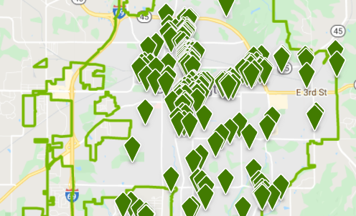
Phase 1 of the 8 Step Implementation Strategy for Partnering with Landlords
Phase 1: Strategic Planning
1
Feedback & Strategic Alignment Session #1
Use feedback to ideate a solution fully representative of CJAM interests and capabilities
Managed by: Inspire Solutions
2
Outreach Preparation
Finalize one page explanation of Round-Up Rent, organize CJAM marketing video, and newsletter
Managed by: Inspire Solutions & UpWork freelance videographer
3
Outreach to Key Property Firms & Landlords
Reach out to the properties to confirm partnerships and walk-through best strategies for implementation.
Managed by: Inspire Solutions & UpWork freelance videographer
Mid Sized Apartment Complexes
+
Small Landlords
=
Large & Diverse Donor Market
10
Notes:
Feedback from CJAM
Inspire Solutions finalizes one pager explanation for round-up rent
Organize marketing video
Hire someone from upwork
1 - 3 months
Talk to property companies/ landlords about program. Start with x number of places we highlighted earlier - finalize partnerships (US)
Outreach to diversity committee (us)
Rollout roundup rent program
Print/ Release t shirts
Work with black business
Marketing video
Set up program to include in 2022 leases if necessary
Newsletter
Gala
Diversity initiatives

Slide 12
Phase 2 of the 8 Step Implementation Strategy for Partnering with Landlords
Phase 2: Implementation
4
Recruiting Diversity Committee
Focusing on organizations with heavy URM populations, send outreach and conduct meetings with interested clients
Managed by: Inspire Solutions & two CJAM Board committee members
5
Feedback & Strategic Alignment Session #2
Get feedback on progress on Round-Up Rent, marketing initiatives, and diversity recruiting to ensure CJAM interests and capabilities are the same
Managed by: Inspire Solutions
6
Launch
By October have all initiatives rolled out to the Bloomington Community
Managed by: Inspire Solutions, working closely with landlords and staff
8
Feedback & Strategic Alignment Session #3
Get feedback on progress so far, survey CJAM employees on their ability to deal with increased capacity, and interview landlords.
Managed by: Inspire Solutions and CJAM leadership
7
Collection
Collect donations from properties, and check in with the diversity committee about progress
Managed by: Inspire Solutions & two CJAM Board committee members
We understand the human capital costs of implementing any recommendation on a small non-profit like CJAM.
Inspire Solutions will work with your team at every step of the way and submit biweekly updates about our progress.
Rent
Marketing
11
Diversity
Notes:
Feedback from CJAM
Inspire Solutions finalizes one pager explanation for round-up rent
Organize marketing video
Hire someone from upwork
1 - 3 months
Talk to property companies/ landlords about program. Start with x number of places we highlighted earlier - finalize partnerships (US)
Outreach to diversity committee (us)
Rollout roundup rent program
Print/ Release t shirts
Work with black business
Marketing video
Set up program to include in 2022 leases if necessary
Newsletter
Gala
Diversity initiatives

Slide 13
The implementation timeline allows CJAM to easily yet efficiently carry out the marketing, diversity committee, and Round-Up Rent tasks
The marketing, diversity committee, and Round-Up Rent tasks can be easily implemented by CJAM staff and Inspire Solutions
Task
June 2021
July
2021
Aug 2021
Sep
2021
Oct
2021
Nov 2021
Dec 2021
Jan 2022
Feb 2022
March 2022
April 2022
May
2022
Marketing Tasks | Complete Marketing Video
 | T-Shirts and Materials
Diversity Committee Tasks | Form Diversity Committee
 | Committee Plans Events / Processes
Round-Up Rent Tasks | Reach Out to Landlords
 | Gain Tenants for Round-Up Rent
12
Notes:
Marketing video - completed during June-July 2021
Form diversity committee (June 2021)
Diversity committee complete tasks (plan ideas around Fall Gala)
Reach out to landlords June - August 2021
T-shirts and marketing materials purchased (August 2021)
Gain tenants for the Round up rent program - September - December 2021

Slide 14
The $10,000 allows for a successful implementation and the Round-Up Rent donation program creates another revenue stream
Breakdown of $10,000:
$2,500
$4,500
$3,000
Marketing Video
CJAM T-Shirts
Diversity Committee
High-quality, professional videographer
Will create an animated video explaining CJAM’s services
T-shirts purchased through a black-owned business
Will get at a minimum 300 quality t-shirts
Helps achieve the committee’s goals of having events and creating new processes
Will ensure all types of clients are included
Round-Up Rent Projection:
# Tenants | 50 | 100 | 250 | 500
Projected Revenue | $3,000 | $6,000 | $15,000 | $30,000
*Assumes the average tenant donates $5 per month for 12 months
**Means CJAM can expect two $3,000 semiannual donations
13
Notes:
Projections based on survey results
100 residents = $6000
Semi annual donation of $3000 from landlords to CJAM
Breakdown of costs and how full $10k will be used (See slides above)

Slide 15
Key risks of firm buy-in, capacity and DEI effectiveness can be mitigated through intentional planning
Risks
Assessment
Mitigation
Few tenants and landlords opt into the system, dissuaded by larger property companies or lack of
CJAM is adding two touchpoints and will at a minimum gain awareness for their services
Severity
Probability
An increase in clients without an increase in volunteer capacity
The added revenue will allow for more volunteers or even staff
Priority
Severity
Probability
Processes to enhance CJAM’s diversity efforts take multiple years and doesn’t increase requirement of diverse volunteers immediately
Establishing relationships with diverse organizations early and continuing to foster those bonds. Encourage the committee to meet quarterly and produce a yearly report to track growth and hold CJAM accountable.
Severity
Probability
14
Notes:
Opt in
Landlord not wanting to partcipate
Two touchpoints
Too many clients/ not enough capacity
Emphasize that they should be doing too much work
Diversity

Slide 16
Appendix Table of Contents
Rent Survey Questions
Round-Up Rent Flow Chart
Landlords Inspire Solutions Reached Out To
UpWork Job Posting Process
Get to Know the Inspire Solutions Team
Duplication Plan
Informational One Pager
List of Potential Commercial Properties
List of Potential Private Properties
T-Shirt Design
Newsletter Example
15

Slide 17
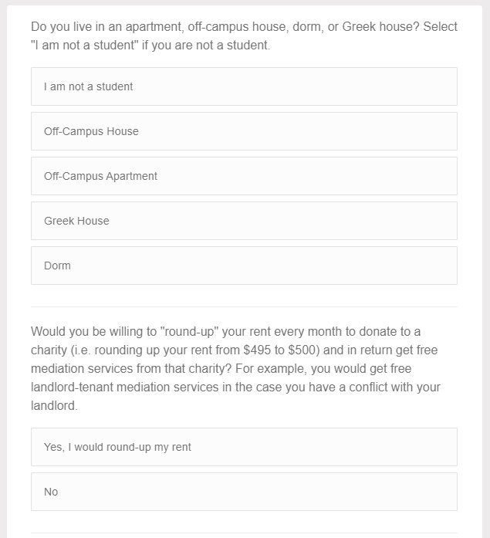
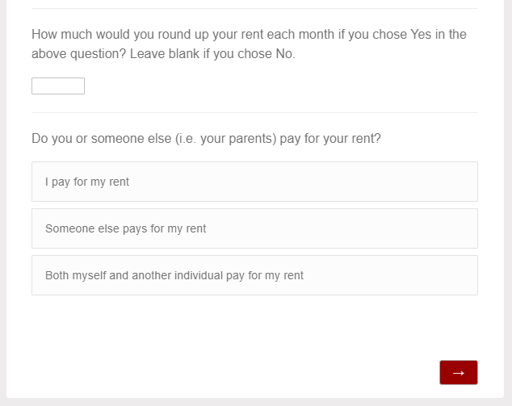
Rent Survey Questions
Questions 1-2
Questions 3-4
16

Slide 18
Round-Up Rent Flow Chart
Smaller landlords:
Larger landlords:
17
Notes:
List of potential landlords (Plato's Closet, Robbie's landlord, Dillion, etc)
Pick one flow chart and put that here
Incentives for landlords/patrons
Save court fees
Explain our understanding of payment system briefly
Improve tenent relationship
Give description to landlords of what CJAM can do for them
What all the parties get (t-shirts, tax deductible?, free services)
Include image of 1 pager given to landlords

Slide 19
Landlords who Inspire Solutions talked with about the Round-Up Rent Program
Chrissie Geels
Owns 11 properties in Bloomington and the surrounding community
Plato’s Court at Knight’s Landing
Large apartment complex north of campus
The Dillon
Large apartment and townhome complex southwest of campus
The Arch
Apartment complex northwest of campus
Evolve
Large apartment complex next to the football stadium
Tenth & College
Apartment complex with a prime location near campus and downtown
18
Notes:
The ark

Slide 20
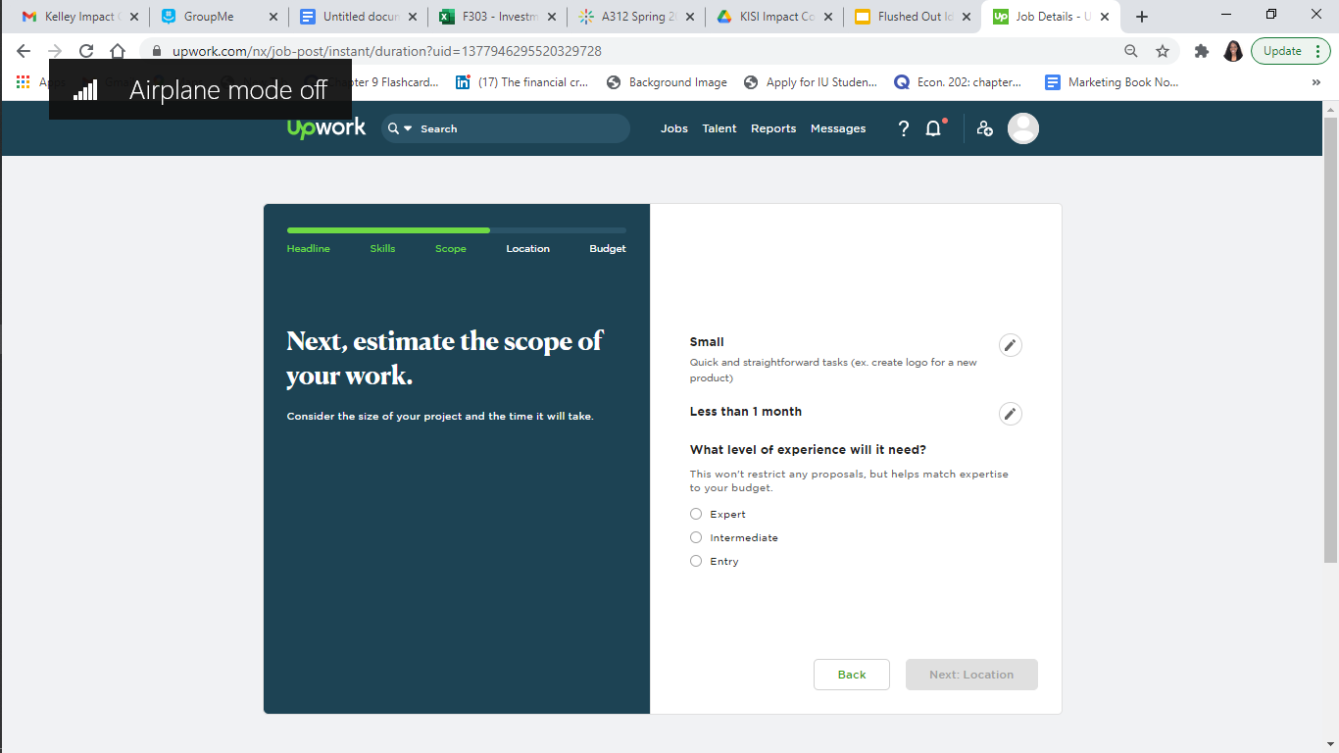
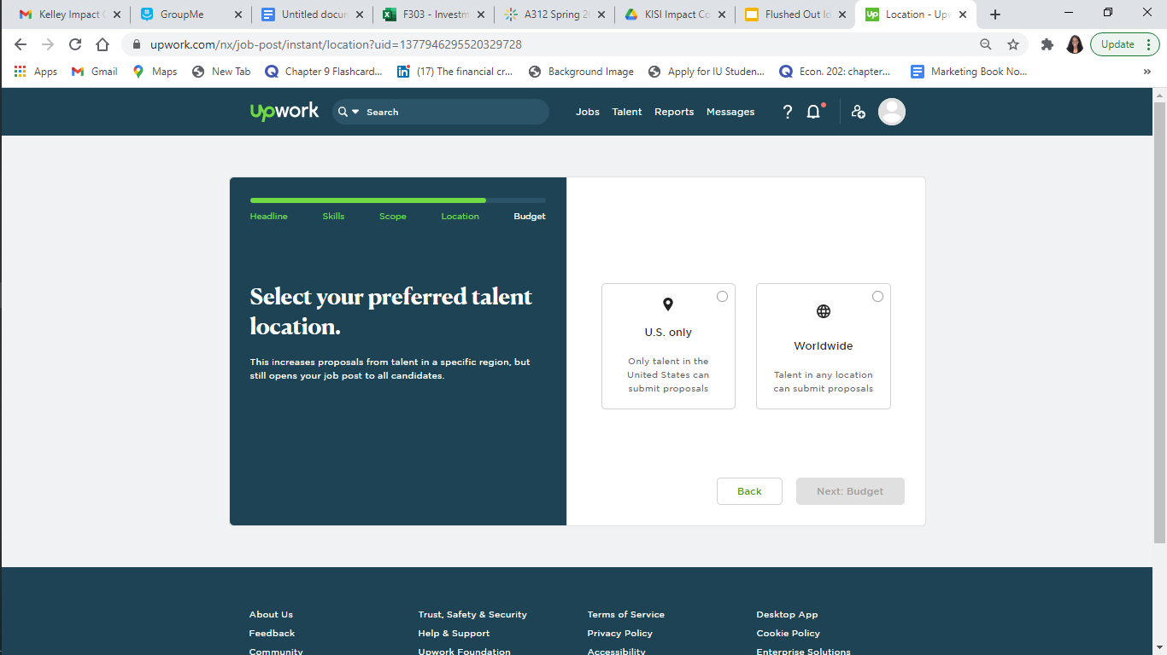
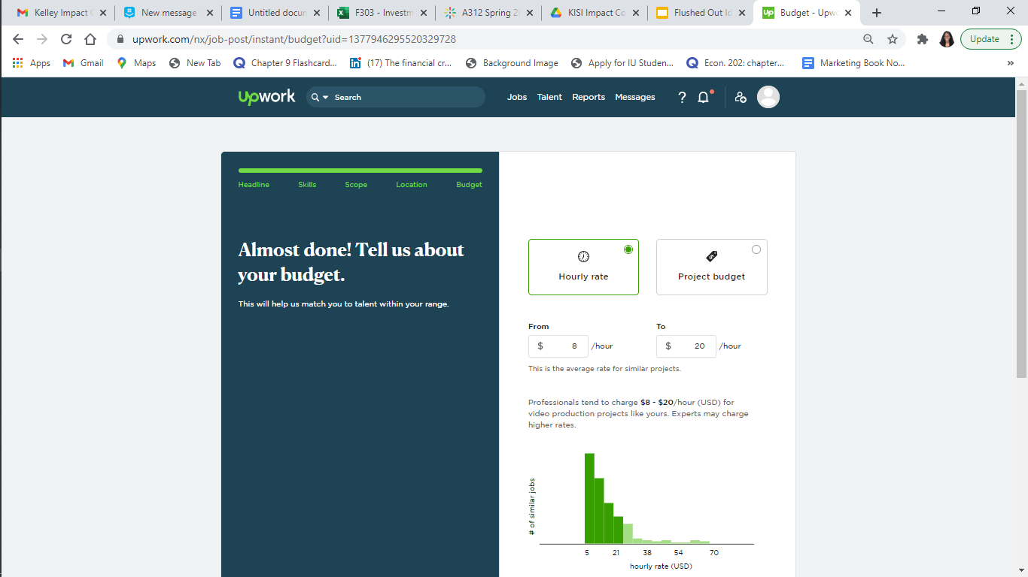
UpWork Job Post Process
1
2
*UpWork is an easy-to-use platform for businesses and individuals to find creative solutions including photographers and videographers
3
4
5
19

Slide 21
Inspire Solutions: Get to know the Team
Davis Aufdembrink
Sika Kodzi
Robbie Levine
Lorraine Michira
Involvement:
Incoming Investment Banking Summer Analyst at William Blair
Capital Markets & Banking Workshop, DSP Business Fraternity, President of Civic Leadership Development Club, Teaching Assistant @ the Kelley School of Business, IU Amazon Prime Campus Manager, Kelley Honors Program Mentor
Involvement:
Incoming Summer Associate at Boston Consulting Group (BCG)
Involvements: Consulting Workshop, Director of Professional Development for Women in Business, DSP Business Fraternity, Kelley Honors Program
Involvement:
Incoming Finance & Accounting intern at Procter & Gamble
Consulting Workshop, IU Athletic Department tutor, 180 Degrees Consulting, DSP Business Fraternity, Kelley School of Business Teaching Assistant, Kelley Honors Program Mentor
Involvement:
Interning as an Audit Intern at KPMG
Global Sales Workshop, Kelley Guide, Best Buddies, Hudson and Holland Tutor, Kelley Black Student Task Force, William R Fry and Hudson and Holland Scholar, State Farm Sales Team Member
20

Slide 22
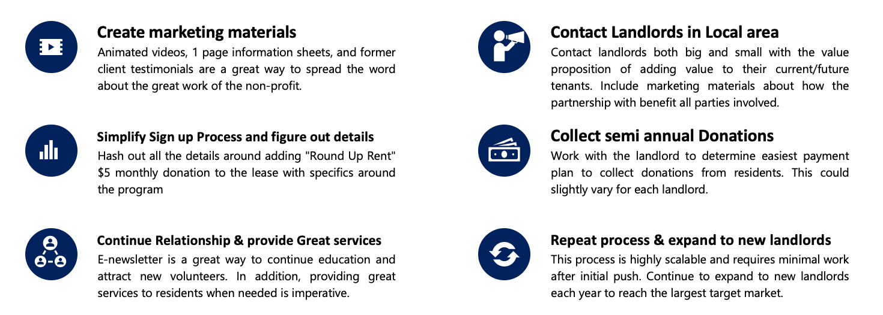
Duplication Plan
21

Slide 23
CJAM 1-Pager (Split in Half)
22

Slide 24
Plato's Court
The Dillon
Cedarview Management
Evolve
Olympus Management
Parker Real Estate Management Abodes, Inc. Elkins Apartments OMEGA Properties The Park on Morton Pavilion Properties Reserve on Third Facilitech Burnham Rentals
The Avenue
Smallwood
Scholar’s Quad Terra Trace Apartments
Potential Landlord Partners
List of Potential Landlord Partners in Bloomington
The Quarters
City Flats on Walnut
Uptown Apartments
Urban Station Apartments
Stadium Crossing
IU Real Estate
Fraternities
Sororities
IU Campus Apartments (Tulip Tree, Union Street, Redbud Hill, Walnut Grove Center, Hillcrest, University East)
Steeplechase (non-student)
Basswood apartments (non-student)
Bloom apartments (non-student)
The Crossing at Pete Ellis (non-student)
Willowbrook (non-student)
Adams Village (non-student)
Bradford Ridge (non-student)
Acadia Court (non-student)
23

Slide 25
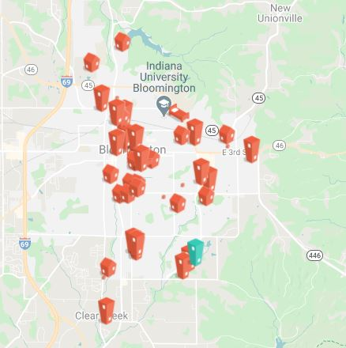
Private Landlords Map
100+
properties in Bloomington that are privately rented
24

Slide 26
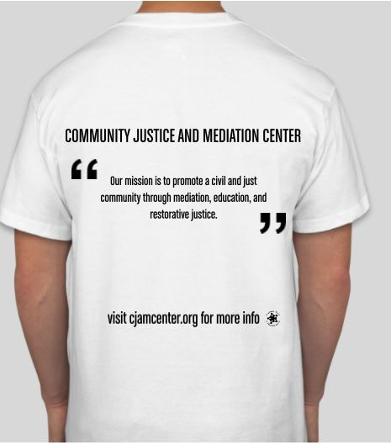
T Shirt Design
FRONT
BACK
The T-shirts can be ordered from ICS Inks Screen Printing and Embroidery for $1.37 per shirt
ICS Inks Screen Printing and Embroidery is a black-owned business in Indianapolis
25

Slide 27
Newsletter Example
26

